Slide 1


Alejandro Sanhueza
11/03/2023

Slide 2

Outline
Executive Summary
Introduction
Methodology
Results
Conclusion
Appendix

Slide 3
Executive Summary
Summary of methodologies
Collect data using SpaceX REST API and Web Scraping
Data Collection with Web Scraping
Data Wrangling
Exploratory Data Analysis with SQL
Exploratory Data Analysis with Data Visualization
Interactive Visual Analytics with Folium
Build Models to predict landing outcomes
Summary of all results
Exploratory Data Analysis result
Visualization/Analytics
Predictive Analytics result

Slide 4
Introduction
Project background and context
SpaceX is a leader in the space industry. His achievements include sending a spacecraft to the ISS, launching a satellite constellation that provides Internet access, and sending manned missions into space. SpaceX is advertising the launch of its $62 million Falcon 9 rocket on its website. Other suppliers are valued at more than $165 million. This difference is possible due to the reuse of the first stage of the Falcon 9 rocket. So if we can determine whether the first stage will land, we can determine the launch cost. This information could be used by a SpaceX competitor. The goal of the project is to create a machine learning pipeline that allows predicting the success of the first stage.
Problems you want to find answers
How payload mass, launch site, number of flights and orbits affect first-stage landing success?
Rate of successful landings over time..
Best predictive model for successful landing.

Slide 5


Slide 6
Methodology
Executive Summary
Data collection methodology:
Collect Data using SpaceX REST API and web scraping from Wikipedia
Perform data wrangling
Wrangle Data by applying one hot encoding to prepare the data for analysis and modeling
Perform exploratory data analysis (EDA) using visualization and SQL
Perform interactive visual analytics using Folium and Plotly Dash
Perform predictive analysis using classification models
Build Models to predict landing outcomes using classification models. Tune and evaluate models to find best model and parameters.

Slide 7
Data Collection
From API
Request data from SpaceX API
Decode response using .json()
Convert to a dataframe using .json_normalize()
From Wikipedia
Request data from Wikipedia
Create BeautifulSoup object from HTML response
Collect data from parsing HTML tables
Create dataframe from data
Exports data to csv files

Slide 8
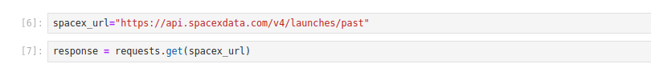
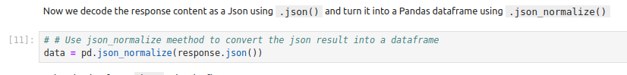
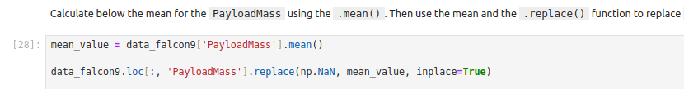
Data Collection – SpaceX API
Request data from SpaceX API
Decode response and convert to dataframe
Filter dataframe
Replace missing values
Export data to csv file
https://github.com/sanhuezalejandro/IBM-Data-Science-Professional-Certificate/blob/main/10-Applied_Data_Science_Capstone/1.%20Spacex-data-collection-api.ipynb

Slide 9
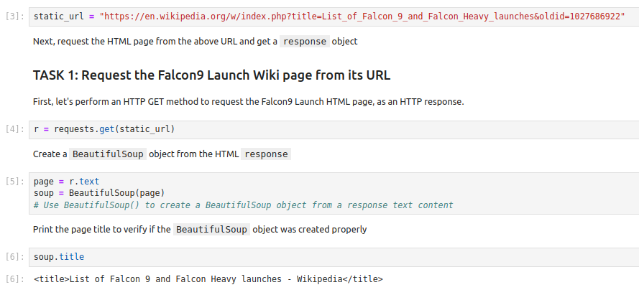
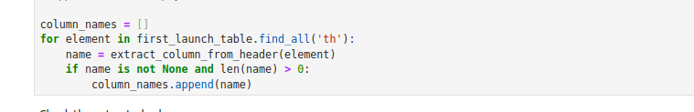
Data Collection - Scraping
Request data from Wikipedia
Create BeautifulSoup object
Extract column names from HTML table header
Collect data from HTML tables
Create dataframe
Export data to csv file
https://github.com/sanhuezalejandro/IBM-Data-Science-Professional-Certificate/blob/main/10-Applied_Data_Science_Capstone/2.%20Webscraping.ipynb

Slide 10
Data Wrangling
Calculate the number of launches on each site use value_counts()
Calculate the number and occurrence of each orbit use value_counts()
Calculate the number and occurence of mission outcome per orbit type use value_counts()
Create a landing outcome label from Outcome column
Export data to csv file
https://github.com/sanhuezalejandro/IBM-Data-Science-Professional-Certificate/blob/main/10-Applied_Data_Science_Capstone/3.%20Data_Wrangling.ipynb

Slide 11
EDA with Data Visualization
Charts
Flight number and payload
Flight number and launch location
Payload mass (kg) depending on the launch site
Payload mass (kg) depending on the type of orbit
Analysis
View relationships using scatter plots
Show comparisons between individual categories using histograms
https://github.com/sanhuezalejandro/IBM-Data-Science-Professional-Certificate/blob/main/10-Applied_Data_Science_Capstone/5.%20Data_Visualization.ipynb

Slide 12
EDA with SQL
Display the names of the unique launch sites in the space mission
Display 5 records where launch site begins with ‘CCA’
Display the total payload mass carried by boosters launched by NASA (CRS)
Display Average payload mass carried by booster version F9 v1.1
List the date when the first succesful landing outcome in ground pad was achieved
List the names of the boosters which have success in drone ship and have payload mass greater than 4000 but less than 6000
List the total number of successful and failure mission outcomes
List the names of the booster_versions which have carried the max payload mass
List the records which will display the month names, failure landing_outcomes in drone ship ,booster versions, launch_site for the months in year 2015
Rank the count of landing outcomes (such as Failure (drone ship) or Success (ground pad)) between the date 2010-06-04 and 2017-03-20, in descending order
https://github.com/sanhuezalejandro/IBM-Data-Science-Professional-Certificate/blob/main/10-Applied_Data_Science_Capstone/4.%20Sql.ipynb

Slide 13
Build an Interactive Map with Folium
• Added red circles at all launch sites coordinates with a popup label
showing its name using its name using its latitude and longitude coordinates
Colored Markers of Launch Outcomes
• Added colored markers of successful (green) and unsuccessful (red)
launches at each launch site to show which launch sites have high success
rates
• Added colored lines to show distance between launch site CCAFS SLC-
40 and its proximity to the nearest coastline, railway, highway, and city
https://github.com/sanhuezalejandro/IBM-Data-Science-Professional-Certificate/blob/main/10-Applied_Data_Science_Capstone/6.%20Launch_site_location.ipynb

Slide 14
Build a Dashboard with Plotly Dash
Dropdown List with Launch Sites
• Allow user to select all launch sites or a certain launch site
Pie Chart Showing Successful Launches
• Allow user to see successful and unsuccessful launches as a percent of the total
Slider of Payload Mass Range
• Allow user to select payload mass range
Scatter Chart Showing Payload Mass vs. Success Rate by Booster Version
• Allow user to see the correlation between Payload and Launch Success
https://github.com/sanhuezalejandro/IBM-Data-Science-Professional-Certificate/blob/main/10-Applied_Data_Science_Capstone/spacex_dash_app.py

Slide 15
Predictive Analysis (Classification)
• Create NumPy array from the Class column
• Standardize the data with StandardScaler. Fit and transform the data.
• Split the data using train_test_split
• Create a GridSearchCV object with cv=10 for parameter optimization
• Apply GridSearchCV on different algorithms: logistic regression, support vector machine, decision tree, K-Nearest Neighbor
• Calculate accuracy on the test data using .score() for all models
• Assess the confusion matrix for all models
https://github.com/sanhuezalejandro/IBM-Data-Science-Professional-Certificate/blob/main/10-Applied_Data_Science_Capstone/7.%20Machine_Learning.ipynb

Slide 16
Results
Exploratory Data Analysis
• Launch success has improved over time
• KSC LC-39A has the highest success rate among landing sites
• Orbits ES-L1, GEO, HEO and SSO have a 100% success rate
Visual Analytics
• Launch sites are far enough away from anything a failed launch can damage
(city, highway, railway), while still close enough to bring people and material
to support launch activities
Predictive Analytics
• Decision Tree model is the best predictive model for the dataset

Slide 17


Slide 18
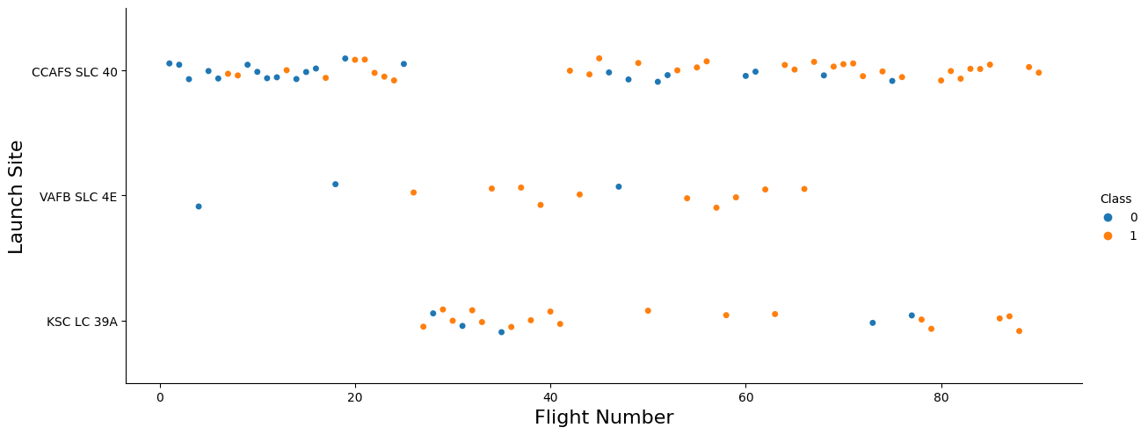
Flight Number vs. Launch Site
Earlier flights have a lower success rate but later flights have a higher success rate
VAFB SLC 4E and KSC LC 39A have higher success rates

Slide 19
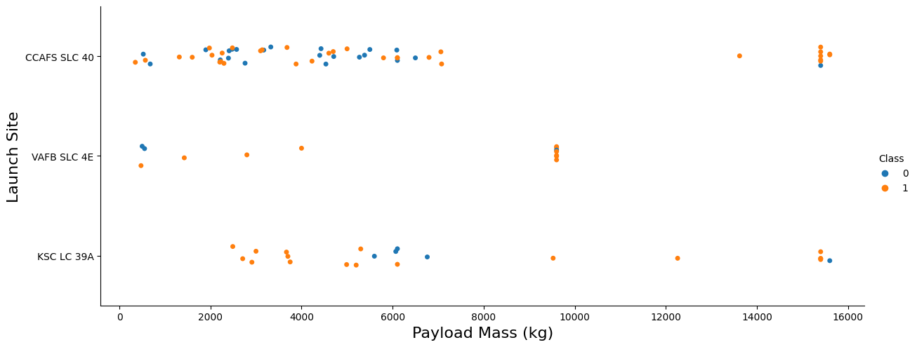
Payload vs. Launch Site
Most launches with a payload mass of more than 7,000 kg were successful
No rockets with a payload mass of more than 10,000 kg were launched from the VAFB SLC 4E launch pad

Slide 20
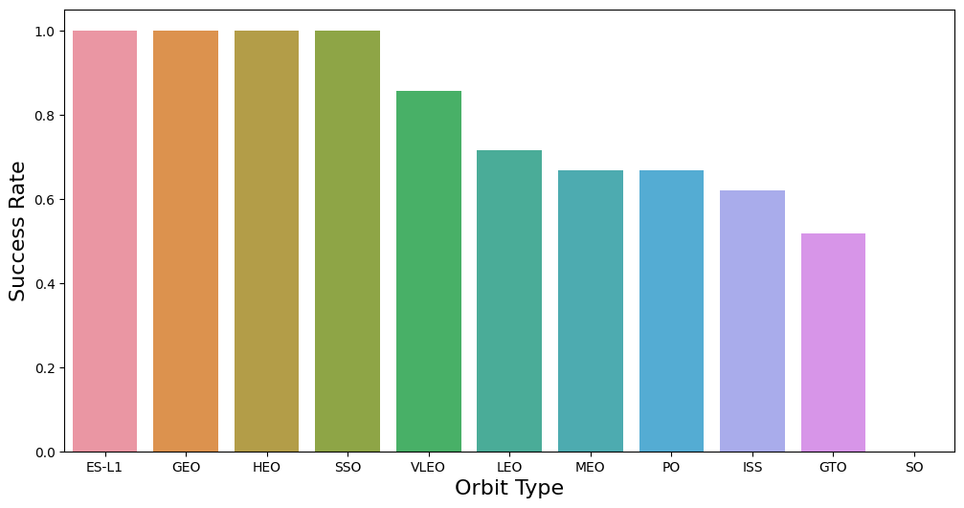
Success Rate vs. Orbit Type
Orbit types ES-L1, GEO, HEO, SSO have a 100% Success rate
Orbit type SO have a 0% Success rate

Slide 21
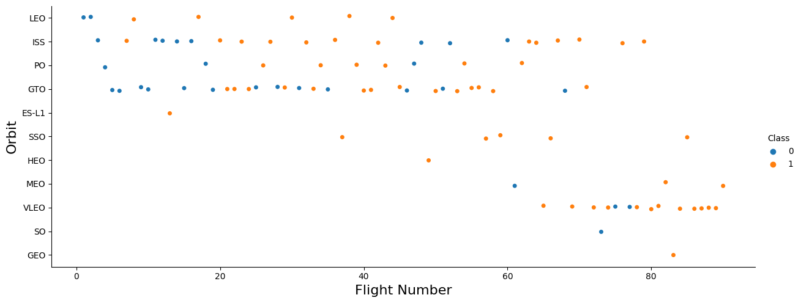
Flight Number vs. Orbit Type
In most cases, the probably of success increases with the number of flights to each orbit
In the case of the GTO orbit, this trend is not observed

Slide 22
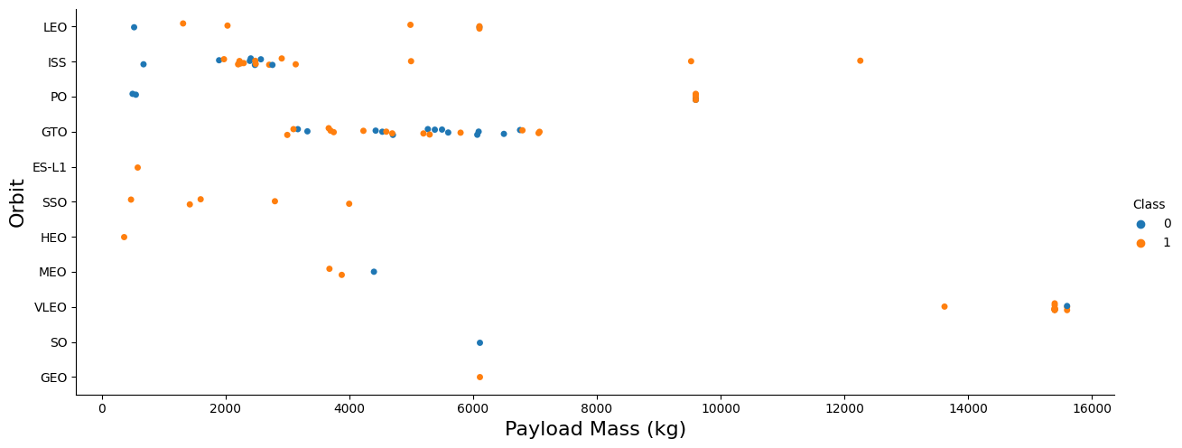
Payload vs. Orbit Type
Launches from LEO, ISS and PO orbits with heavy payloads are successful
Heavy payload GTO launches have had mixed success

Slide 23
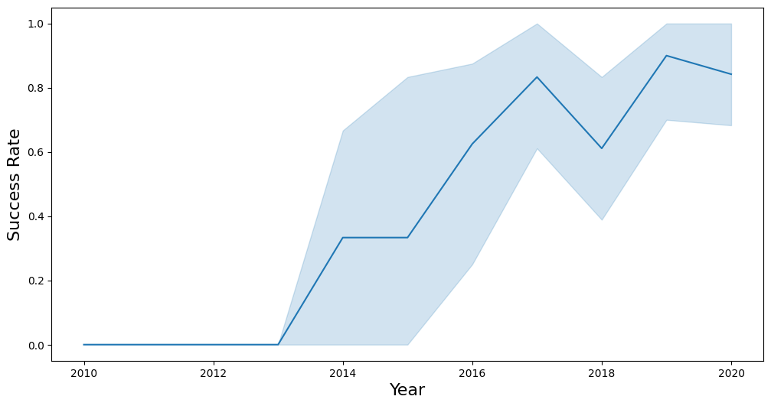
Launch Success Yearly Trend
The Success Rate since 2013 kept increasing till 2017 (stable 2014)

Slide 24
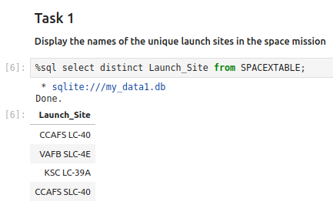
All Launch Site Names
Launch Site Names
CCAFS LC-40
VAFB SLC-4E
KSC LC-39A
CCAFS SLC-40

Slide 25
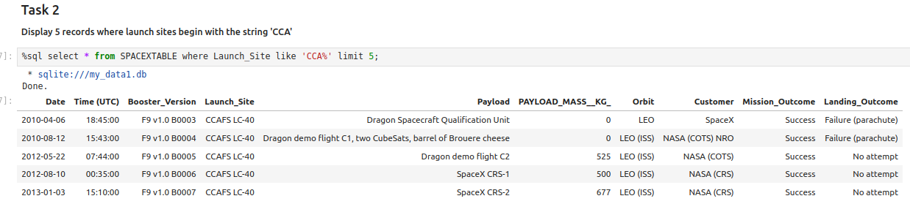
Launch Site Names Begin with 'CCA'
To perform this task, use the following query:
%sql select * from SPACEXTABLE where Launch_Site like 'CCA%' limit 5;

Slide 26
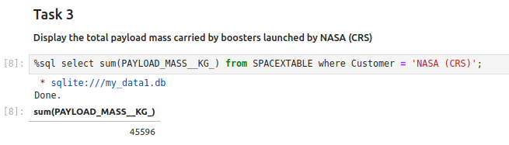
Total Payload Mass
Total payload Mass = 45,596 kg carried by boosters launched by NASA (CRS)

Slide 27
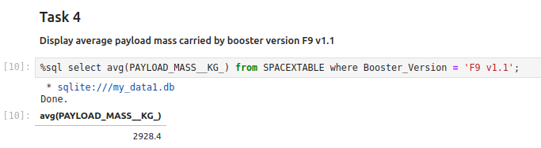
Average Payload Mass by F9 v1.1
Average Payload Mass = 2,928 kg carried by booster version F9 v1.1

Slide 28
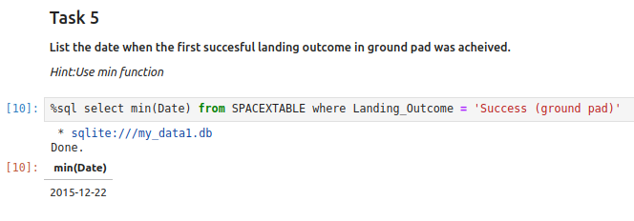
First Successful Ground Landing Date
First successful landing outcome in ground pad was 2015-12-22

Slide 29
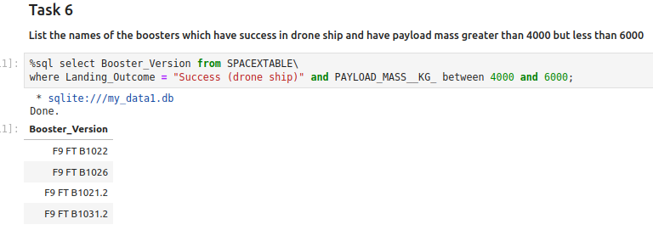
Successful Drone Ship Landing with Payload between 4000 and 6000
Boosters which have success in drone ship and have payload mass greater than 4000 but less than 6000:
- F9 FT B1022, F9 FT B1026, F9 FT B1021.2, F9 FT B1031.2

Slide 30
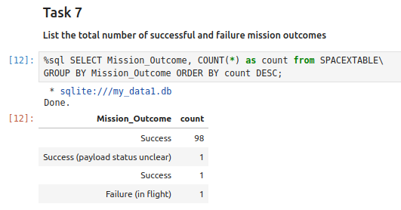
Total Number of Successful and Failure Mission Outcomes
Success – 99
Success (payload status unclear) – 1
Failure (in flight) - 1

Slide 31
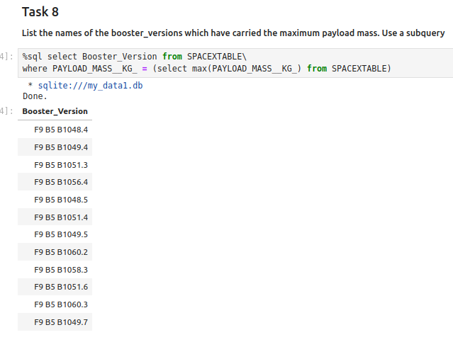
Boosters Carried Maximum Payload
Carrying Max Payload
• F9 B5 B1048.4
• F9 B5 B1049.4
• F9 B5 B1051.3
• F9 B5 B1056.4
• F9 B5 B1048.5
• F9 B5 B1051.4
• F9 B5 B1049.5
• F9 B5 B1060.2
• F9 B5 B1058.3
• F9 B5 B1051.6
• F9 B5 B1060.3
• F9 B5 B1049.7

Slide 32
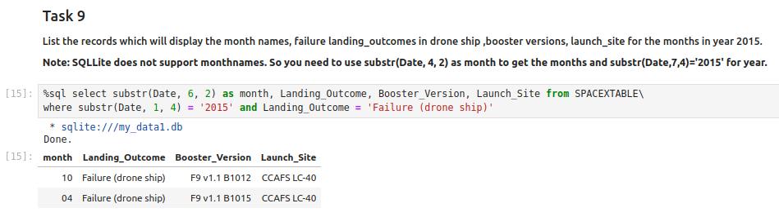
2015 Launch Records
Showing month, date, booster version, launch site and landing outcome

Slide 33
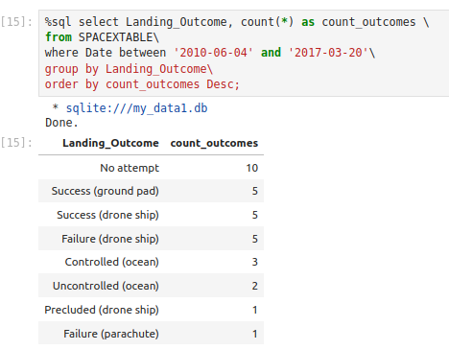
Rank Landing Outcomes Between 2010-06-04 and 2017-03-20
Rank the count of landing outcomes between 2010-06-04 and 2017-03-20 in descending order

Slide 34


Slide 35
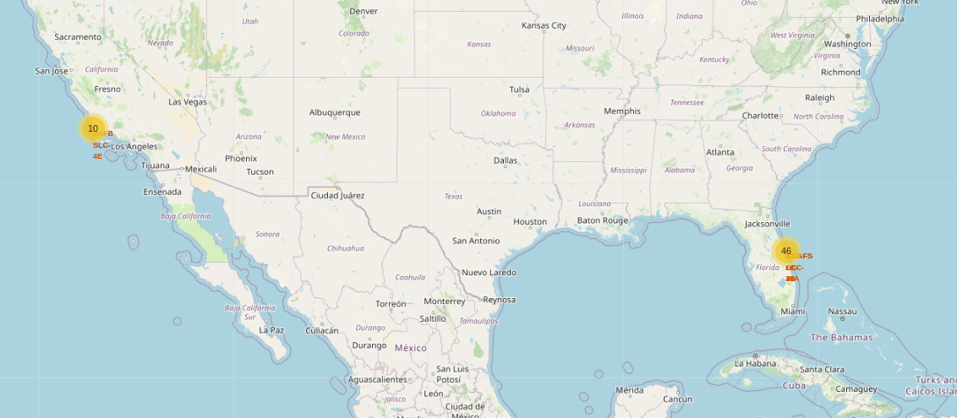
All launch sites map markers

Slide 36
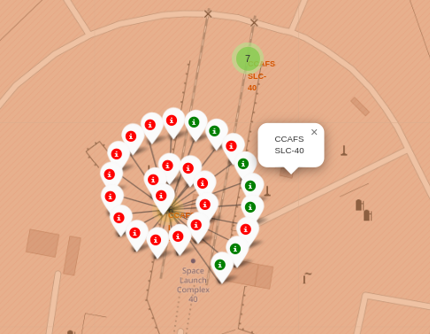
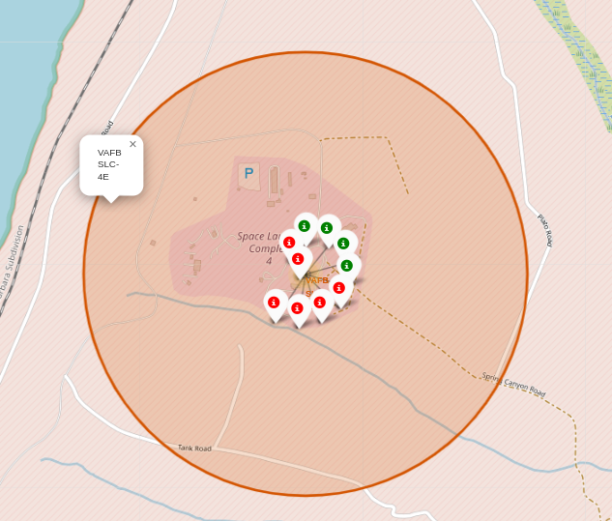
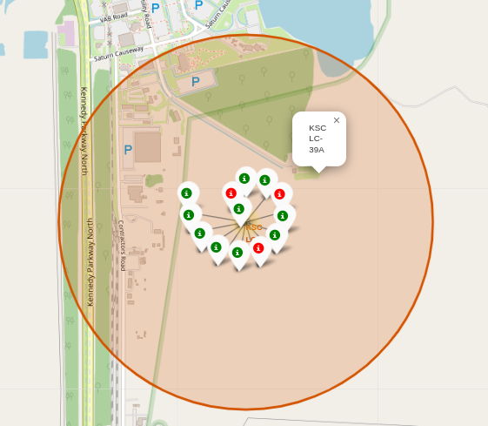
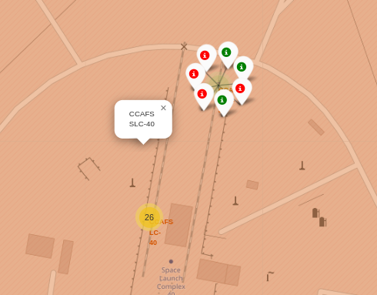
Markers showing launch sites with color labels
• Green markers for successful launches
• Red markers for unsuccessful launches

Slide 37
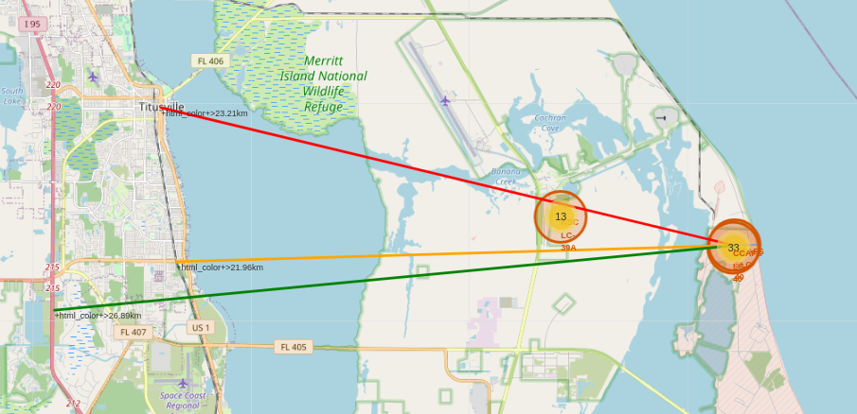
Launch Site distance to landmarks
City Distance 23.21 km
Railway Distance 21.96 km
Highway Distance 26.89 km
Coastline Distance 0.87 km

Slide 38


Slide 39
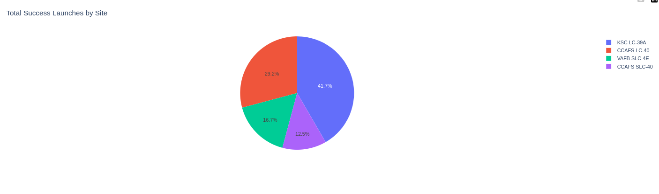
Launch Success by Site
The piechart displays the percentage of the total number of successful launches
KSC LC-39A has the highest rate - 41.7%

Slide 40
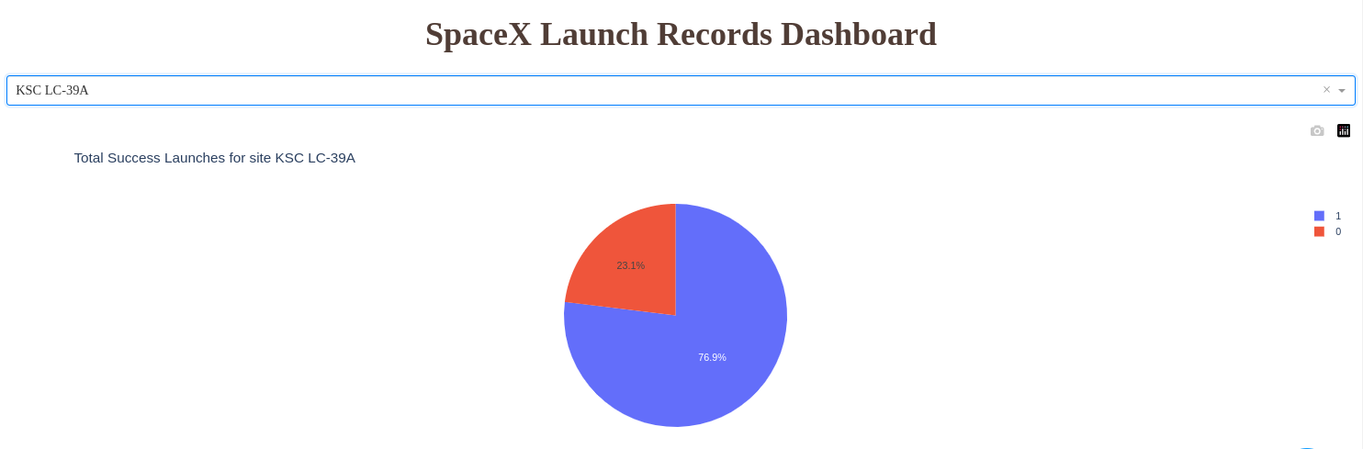
Launch Success (KSC LC-39A)
KSC LC-39A has the highest success rate - 76.9%

Slide 41
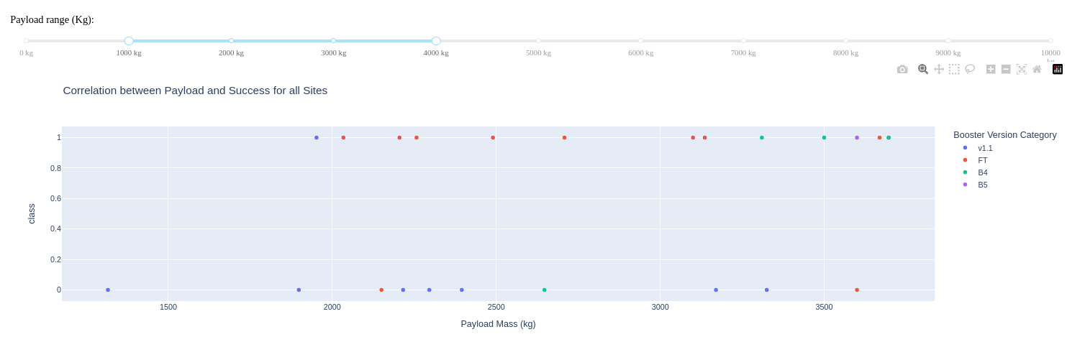
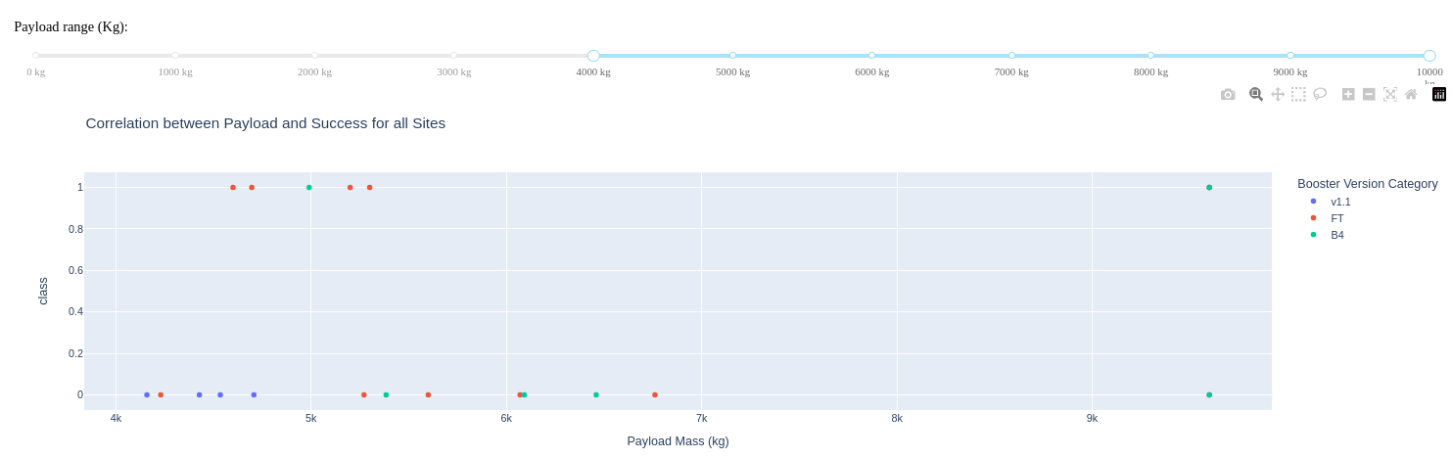
Payload Mass and Success
Payloads between 1,000 kg and 4,000 kg have the highest success rate
Payloads between 4,000 kg and 10,000 kg have the highest success rate

Slide 42


Slide 43
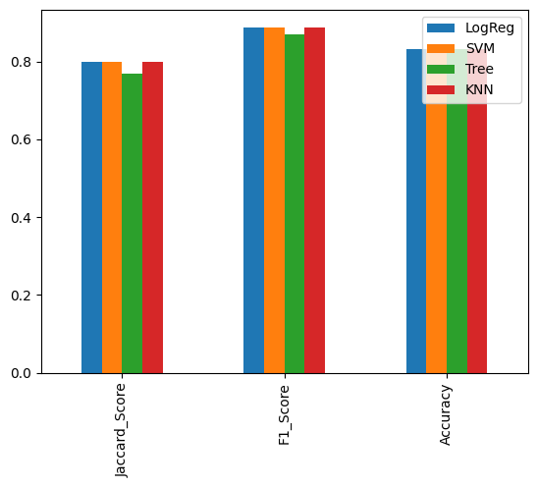
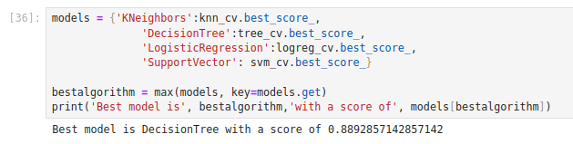
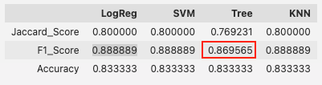
Classification Accuracy
Best model in Training is DecisionTree with a score of 0.889 (in-sample)
Best params is : {'criterion': 'entropy', 'max_depth': 16, 'max_features': 'sqrt', 'min_samples_leaf': 1, 'min_samples_split': 2, 'splitter': 'random’}
But in our Test (out-sample) the best models are LogReg, SVM and KNN with F1 Score of 0.889,
DecisionTree is 0.869.

Slide 44
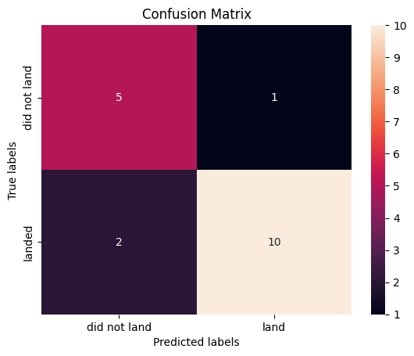
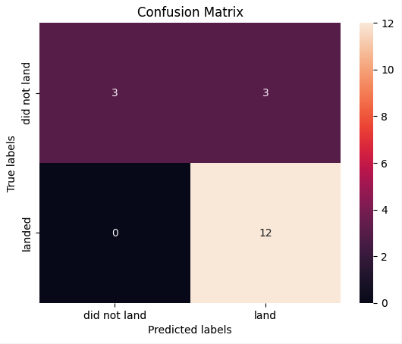
Confusion Matrix
Decision Tree
LogReg, SVM, KNN
Confusion Matrices: Decision Tree:
TP: 10
FP: 1
TN: 5
FN: 2
Other Models (LogReg, SVM, KNN):
TP: 12
FP: 3
TN: 3
FN: 0
Decision Tree: Higher false negatives (FN=2) compared to other models (FN=0).
Others (LogReg, SVM, KNN): Lower false negatives, indicating better prediction of successful landings.

Slide 45
Conclusions
• Recommendation: Utilize models with lower false negatives (LogReg, SVM, KNN) for accurate prediction of Falcon 9 first stage landings.
• Coast: All the launch sites are close to the coast
• Launch Success: Increases over time
• KSC LC-39A: Has the highest success rate among launch sites.
• Orbits: ES-L1, GEO, HEO, and SSO have a 100% success rate
• Payload Mass: Across all launch sites, the higher the payload mass (kg), the higher the success rate

Slide 46


